Slide 2
TIME MANIPULATION

Slide 3
Lecture# 1

Slide 4
HISTORY
Most of PHP's date functions work on the basis of timestamps.
This timestamp is a unique numeric representation of a particular date, calculated as the number of seconds between January 1 1970 and the date and time specified, and makes it easier to perform arbitrary calculations on date and time values.

Slide 5
A timestamp
In General Terms…

Slide 6
What is TIMESTAMP?
A timestamp is a sequence of characters or encoded information identifying when a certain event occurred. Usually giving date and time of day, sometimes accurate to a small fraction of a second.
The term derives from rubber stamps used in offices to stamp the current date, and sometimes time, in ink on paper documents, to record when the document was received.
A common example of this type of timestamp is a postmark on a letter. However, in modern times usage of the term has expanded to refer to digital date and time information attached to digital data.
For example, computer files contain timestamps that tell when the file was last modified, and digital cameras add timestamps to the pictures they take, recording the date and time the picture was taken.

Slide 7
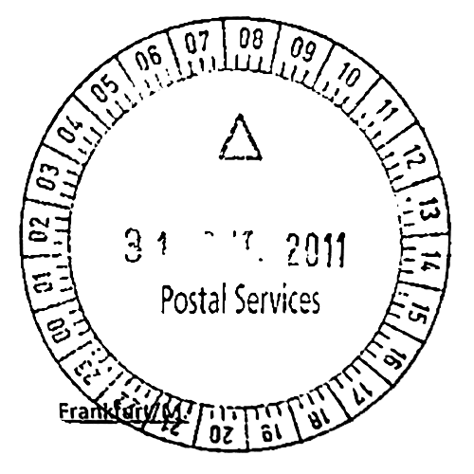
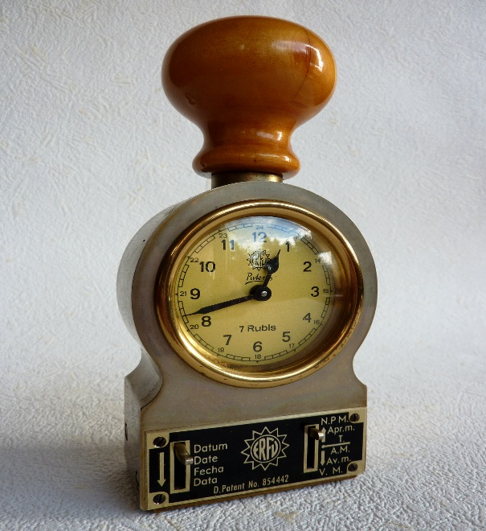
A timestamp is the time at which an event is recorded by a computer. In many cases, the difference may be inconsequential: the time at which an event is recorded by a timestamp (e.g. entered into a log file) should be very, very close to the time of the occurrence of the event recorded.

Slide 8
UNIX TIMESTAMP (link)
UNIX (Uniplexed Information & Computing Service)
The unix time stamp is a way to track time as a running total of seconds. This count starts at the Unix Epoch on January 1st, 1970.
Therefore, the unix time stamp is merely the number of seconds between a particular date and the Unix Epoch. This is very useful to computer systems for tracking and sorting dated information in dynamic and distributed applications both online and client side.
Unix time is a single signed integer number which increments every second, without requiring the calculations to determine year, month, day of month, hour and minute required for intelligibility to humans. Modern Unix time is based on UTC
Unix time may be checked on some Unix systems by typing date +%s on the command line.

Slide 9
What will happen on January 19, 2038?
On this date the Unix Time Stamp will cease to work due to a 32-bit overflow. Before this moment millions of applications will need to either adopt a new convention for time stamps or be migrated to 64-bit systems which will buy the time stamp a "bit" more time.

Slide 10
UTC (Coordinated Universal Time)
Coordinated Universal Time (UTC) is the primary time standard by which the world regulates clocks and time. It is one of several closely related successors to Greenwich Mean Time (GMT). For most common purposes, UTC is synonymous with GMT, but GMT is no longer precisely defined by the scientific community.
The UTC standard was officially standardized in 1961 by the International Radio Consultative Committee (IRCC), having been initiated by several national time laboratories. The system was adjusted several times until leap seconds were adopted in 1972 to simplify future adjustments.

Slide 11
EPOCH
a fixed point of time, established in history by the occurrence of some grand or remarkable event; a point of time marked by an event of great subsequent influence; as, the epoch of the creation; the birth of Christ was the epoch which gave rise to the Christian era
an arbitrary fixed date, for which the elements used in computing the place of a planet, or other heavenly body, at any other date, are given; as, the epoch of Mars; lunar elements for the epoch March 1st, 1860

Slide 12
Greenwich Mean Time (GMT)
Greenwich Mean Time (GMT) is a time system originally referring to mean solar time at the in Greenwich, London, which later became adopted as a global time standard.
It is arguably the same as Coordinated Universal Time (UTC) and when this is viewed as a time zone the name Greenwich Mean Time is especially used by bodies connected with the United Kingdom, such as the BBC World Service, the Royal Navy, the Met Office and others particularly in Arab countries, such as the Middle East Broadcasting Center.
Before the introduction of UTC on 1 January 1972, Greenwich Mean Time (also known as Zulu time)

Slide 13
FUNCTIONS

Slide 14
mktime()
mktime(hours,minutes,seconds,month,date,year,is_dts)
mktime() function tells us the total number of seconds 1 January 1970.
In PHP, timestamps are created via the mktime() function, which accepts a series of date and time parameters, and converts them into a timestamp. Here's an example:
<?php
  // get a timestamp for 10:00:00 March 9 2012
  echo mktime(10, 00, 00, 3, 9, 2012);
?>
Note: timestamp means number of seconds from 1 January 1970 till your mentioned time.

Slide 15
date()
Php date() function formats a timestamp to a more readable date and/or time.
syntax date(format,timestamp)
format Required. Specifies the format of the timestamp
Timestamp Optional. Specifies a timestamp. Default is the current date and time
Example:
<?php
  echo date(“D-M-Y”);
  ?>

Slide 16
date() continued…
<?php
$today = date("j");
$thisMonth = date("n");
$thisYear = date("Y");
//How to get the day 3 days from now:
echo date("F j Y", mktime(0,0,0, $thisMonth, $today+3, $thisYear));
//1 week from now:
list($today,$thisMonth,$thisYear) = explode(" ", date("j n Y"));
echo date("F j Y", mktime(0,0,0, $thisMonth, $today+7, $thisYear));
//4 months from now:
list($today,$thisMonth,$thisYear) = explode(" ", date("j n Y"));
echo date("F j Y", mktime(0,0,0, $thisMonth+4, $today, $thisYear));
//3 years, 2 months and 35 days from now:
list($today,$thisMonth,$thisYear) = explode(" ", date("j n Y"));
echo date("F j Y", mktime(0,0,0, $thisMonth+2, $today+35, $thisYear+3));
?>

Slide 17
time()
The time() function returns the current time as a Unix timestamp (the number of seconds since January 1 1970 00:00:00 GMT).
<?php
$t=time();
echo $t;
?>

Slide 18
Assignments
Make 6 pages.
Count total time stayed on each of page 1 to page 5.
Show result of total time stayed on each of the page (page 1 to 5) on page 6 (result page).
Note: e.g; you visit page1 and then result page(page 6), if you again visit page1, the previous interval should be added to current interval stayed.
Make a textarea, a combobox and a submit button.
Enter text in textarea, select value from combobox. On submit, text should be shown upto time selected.

